Slide 1
PROBLEM SOLVING
Programming 511
Prog511, Topic 1
Mr N. Mathenjwa

Slide 2
Learning Objectives
Topic 1: PROBLEM SOLVING Lecturer 1-6
1.1. Introduction ................................................................................................................................. 5
1.2. Performing a Task on the Computer? ......................................................................................... 5
1.3. Program Planning ........................................................................................................................ 6
1.4.2. Programming Tools .................................................................................................................. 8
1.4.3 Flow Charts .............................................................................................................................. 8
1.4.4 Pseudo Code .......................................................................................................................... 11
1.4.5 Hierarchy Charts .................................................................................................................... 12

Slide 3
Introduction
Hardware refers to the machinery in a computer system (such as the monitor, keyboard, and CPU) and software refers to a collection of instructions, called a program that directs the hardware. Programs are written to solve problems or perform tasks on a computer.
Programmers translate the solutions or tasks into a language the computer can understand. As we write programs, we must keep in mind that the computer will only do what we instruct it to do. Because of this, we must be very careful and Precise with our instructions. Note: A program is also known as a project, application, or solution.

Slide 4
What is a programming language?
A programming language is set of rules that provides a way of telling a computer:
What operations to perform
Communicating an algorithm
Receives an input from the user and generates an output.
A programming language is a system for describing a computation (math) or algorithms (logic) in a machine-readable and human readable form.
Has words, symbols, and grammatical rules (natural language)
Grammatical rules = Syntax
Each language has a different set of syntax rules
Has semantics (meaning)
Computer programs can help cure diseases; drive cars; create video games; make animated movies/graphics; build websites and apps; and much more.
\

Slide 5
Performing a Task on the Computer
The first step in writing instructions to carry out a task is to determine what the output should be, that is exactly what the task should produce.
The second step is to identify the data, or input, necessary to obtain the output.
The last step is to determine how to process the input to obtain the desired output, that is, to determine what formulas or ways of doing things can be used to obtain the output.

Slide 6
Performing a Task on the Computer
This problem-solving approach is the same as that used to solve word problems in an algebra class. For example, consider the following algebra problem:
How fast is a car travelling if it goes 50 miles in 2 hours?
The first step is to determine the type of answer requested. The answer should be a number giving the speed in miles per hour (the output). (Speed is also called velocity.) The information needed to obtain the answer is the distance and time the car has travelled (the input).

Slide 7
Performing a Task on the Computer
The formula:
Is used to process the distance travelled and the time elapsed in order to determine the speed. That is,
Speed = Distance/Time
Speed = 50 miles / 2 hour=25m/h

Slide 8
Performing a Task on the Computer
A pictorial representation of this problem-solving process is
We determine what we want as output, get the needed input, and process
the input to produce the desired output. In the following chapters we discuss
how to write programs to carry out the preceding operations. But first we look
at the general process of writing programs.

Slide 9
Flow Charts
See the next set of slides 4.Flowcharts

Slide 10
Pseudo Code
Pseudo code is an abbreviated plain English version of actual computer code (hence, pseudo code). The geometric symbols used in flowcharts are replaced by English-like statements that outline the process. As a result, pseudo code looks more like computer code than does a flowchart.
Pseudo code allows the programmer to focus on the steps required to solve a problem rather than on how to use the computer language. The programmer can describe the algorithm in Visual Basic-like form without being restricted by the rules of Visual Basic. When the pseudo code is completed, it can be easily translated into the Visual Basic language.

Slide 11
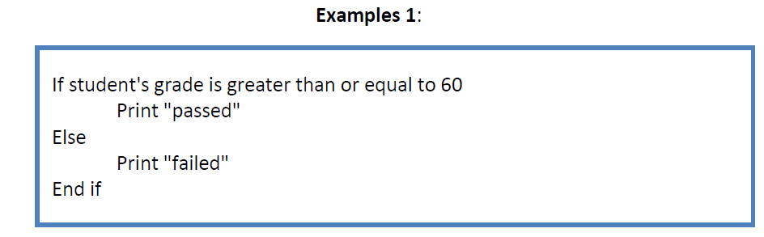
Pseudo Code
The rules of Pseudocode are reasonably straightforward. All statements showing "dependency" are to be indented. These include while, do, for, if, switch. Examples below will illustrate this notion.
Pseudocode that checks if a grade is below or above 60.

Slide 12
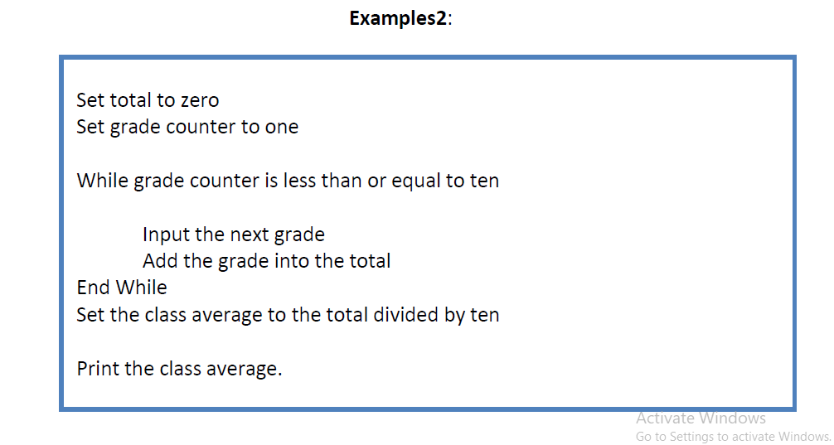
Pseudo Code
Pseudocode that counts the class average given the number of grades.

Slide 13
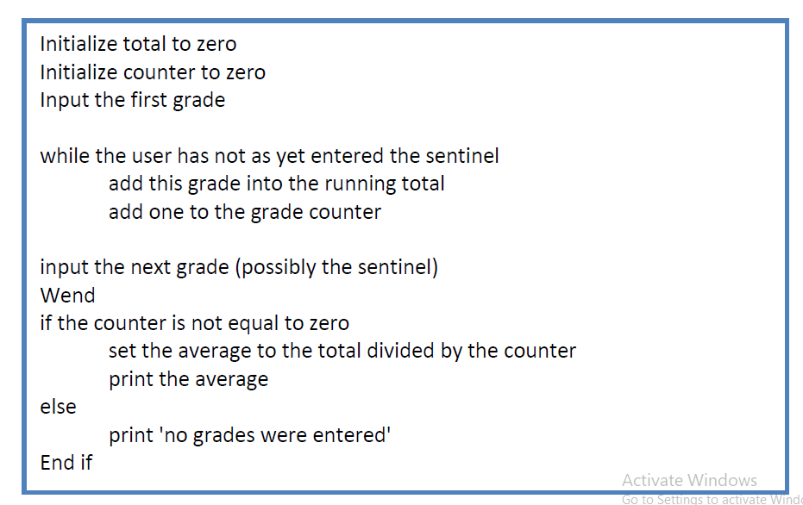
Pseudo Code
Pseudocode that counts the class average without given the number of grades.

Slide 14
Hierarchy Charts
A Hierarchy Chart (hierarchical diagram) shows the breakdown of a system to its lowest manageable parts. It is a top-down modular design tool, constructed of rectangles (that represents the different modules in a system) and lines that connect them.
What are Hierarchy Charts used for?
As mentioned above their main purpose is to describe the structure and hierarchy of an entity. This entity could be a strategy, event, software program, and so on. Basically the hierarchy chart is suitable in any situation that aims to present the organized structure of a material or an abstract entity.

Slide 15
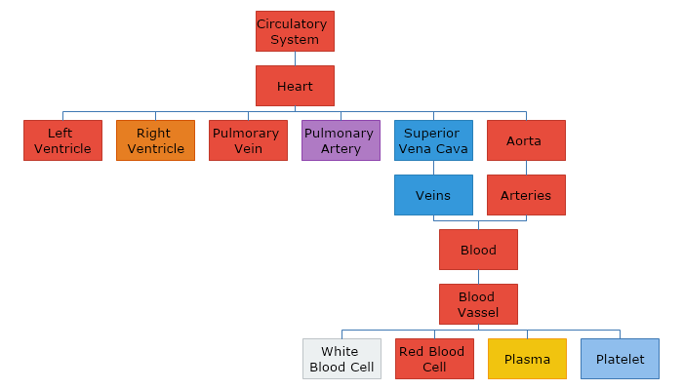
Hierarchy Charts

Slide 16
End of chapter 1!!!!!

